Slide 1
HTTPS Decryption & SSL Unpinning for Android Apps

Slide 2
DISCLAIMER: This guide is intended exclusively for lawful research, debugging, and development activities. The techniques described herein must only be applied to applications owned by the user or those with explicit, documented permission for testing. All information is to be used strictly in non-production environments.
Misuse of the material may breach laws or regulations, for which the user assumes full responsibility. The author disclaims liability for unauthorized or unethical application of these methods

Slide 3
Required Tools
Android Studio (https://developer.android.com/studio)
Google Platform Tools (https://developer.android.com/tools/releases/platform-tools)
CharlesProxy (https://www.charlesproxy.com/)
rootAVD (https://github.com/newbit1/rootAVD)
MagiskTrustUserCerts (https://github.com/NVISOsecurity/MagiskTrustUserCerts)

Slide 4
Additional Tools
android-unpinner (https://github.com/mitmproxy/android-unpinner)
JustTrustMe (https://github.com/Fuzion24/JustTrustMe)

Slide 5
Useful Resources
ApkMirror.com
Aurora Store App (https://gitlab.com/AuroraOSS/AuroraStore/-/releases)
Apkeditor.io

Slide 6
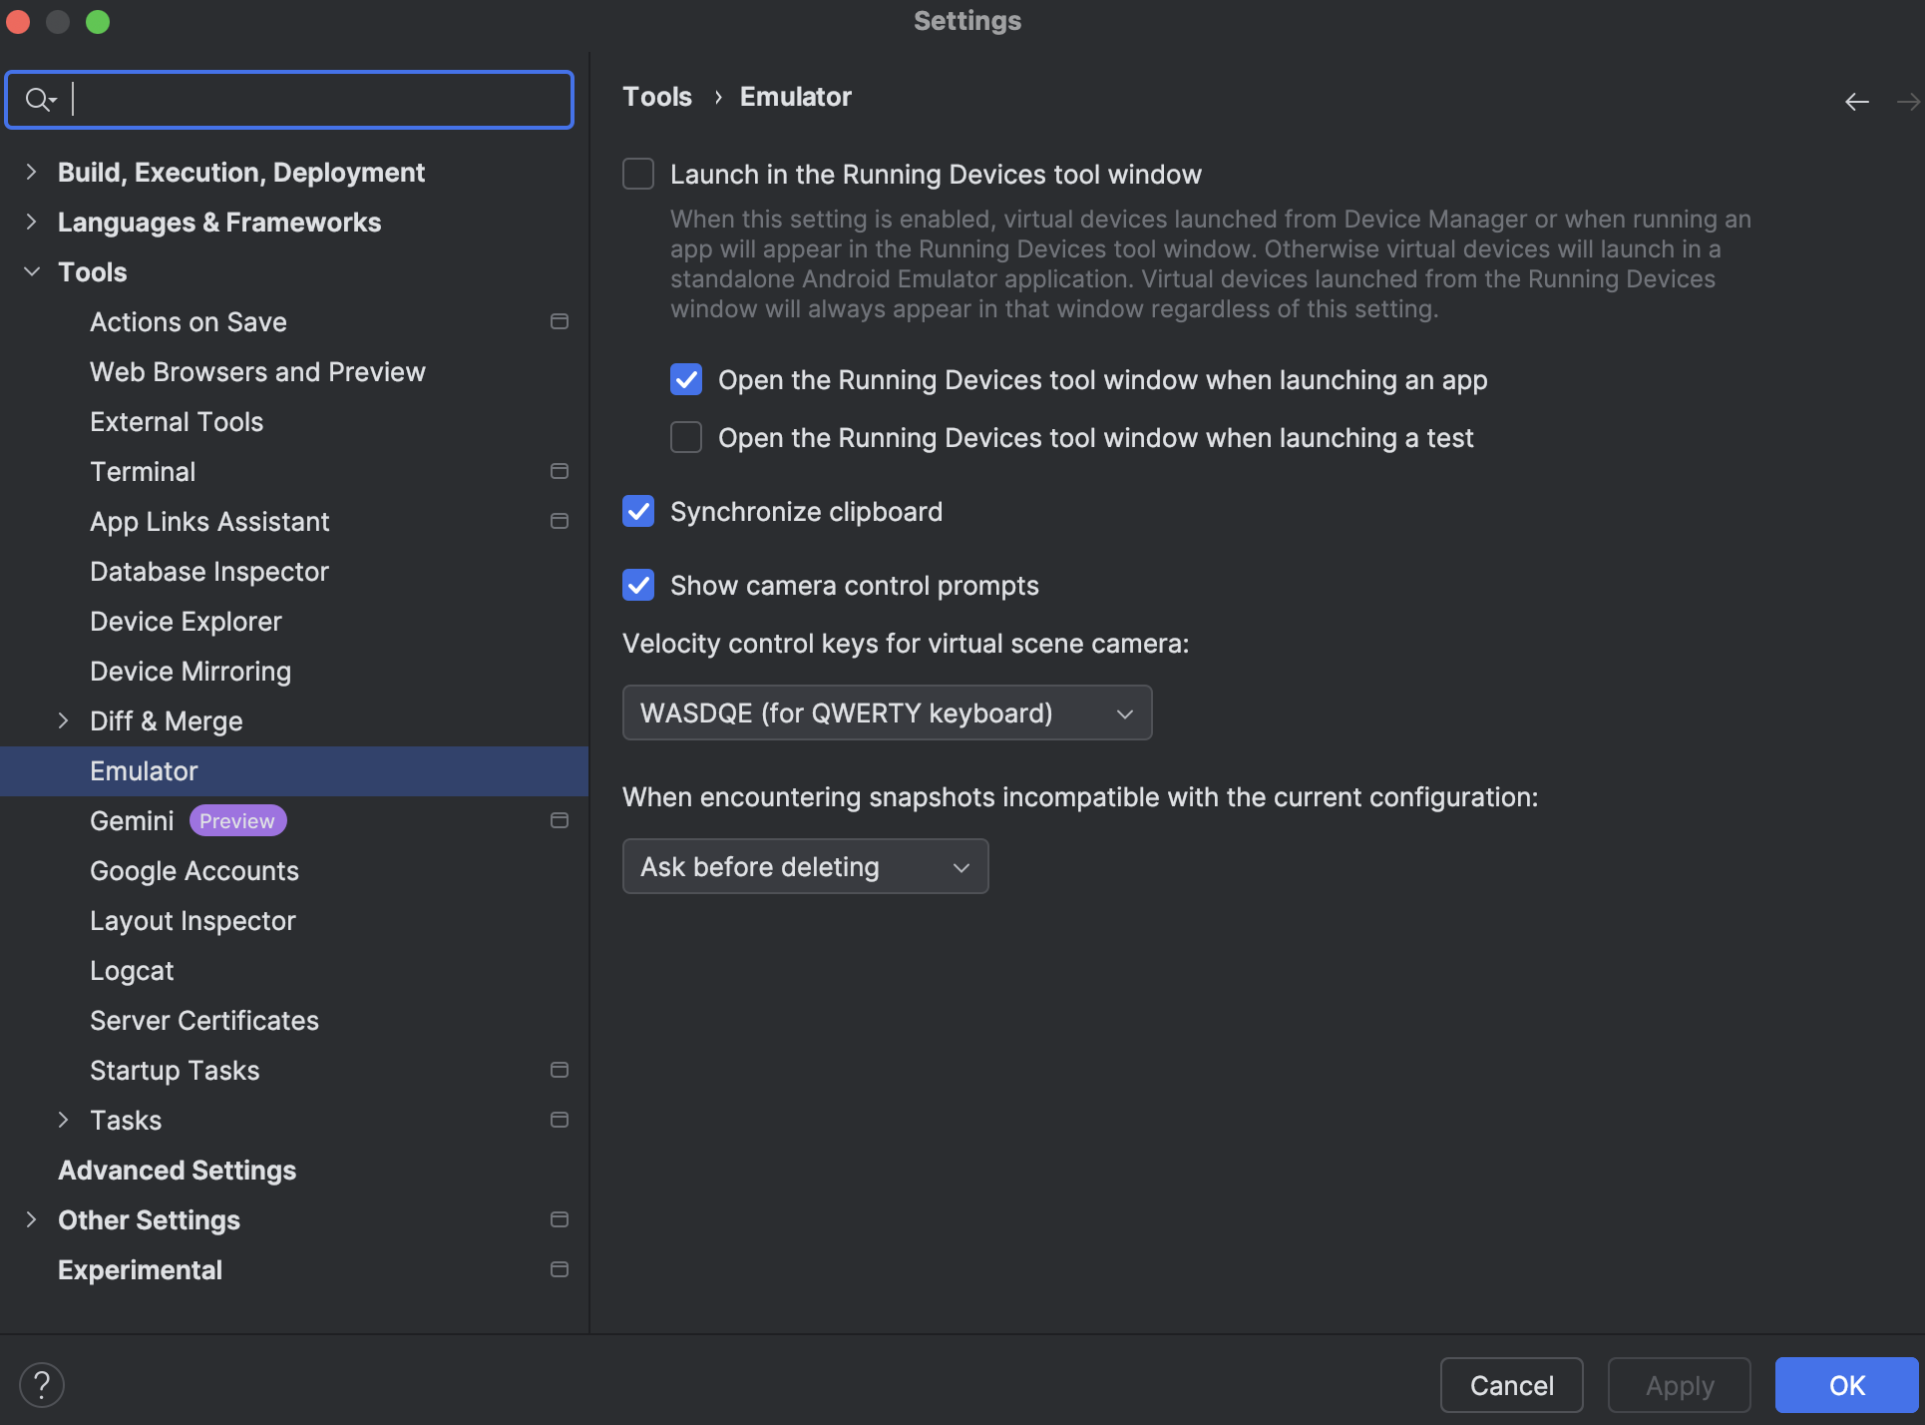
Step 1: Installing Android Studio
Download and install Android Studio.
Launch it, head over to Settings>Tools>Emulator and uncheck:
“Launch in the Running Device tool window”

Slide 7
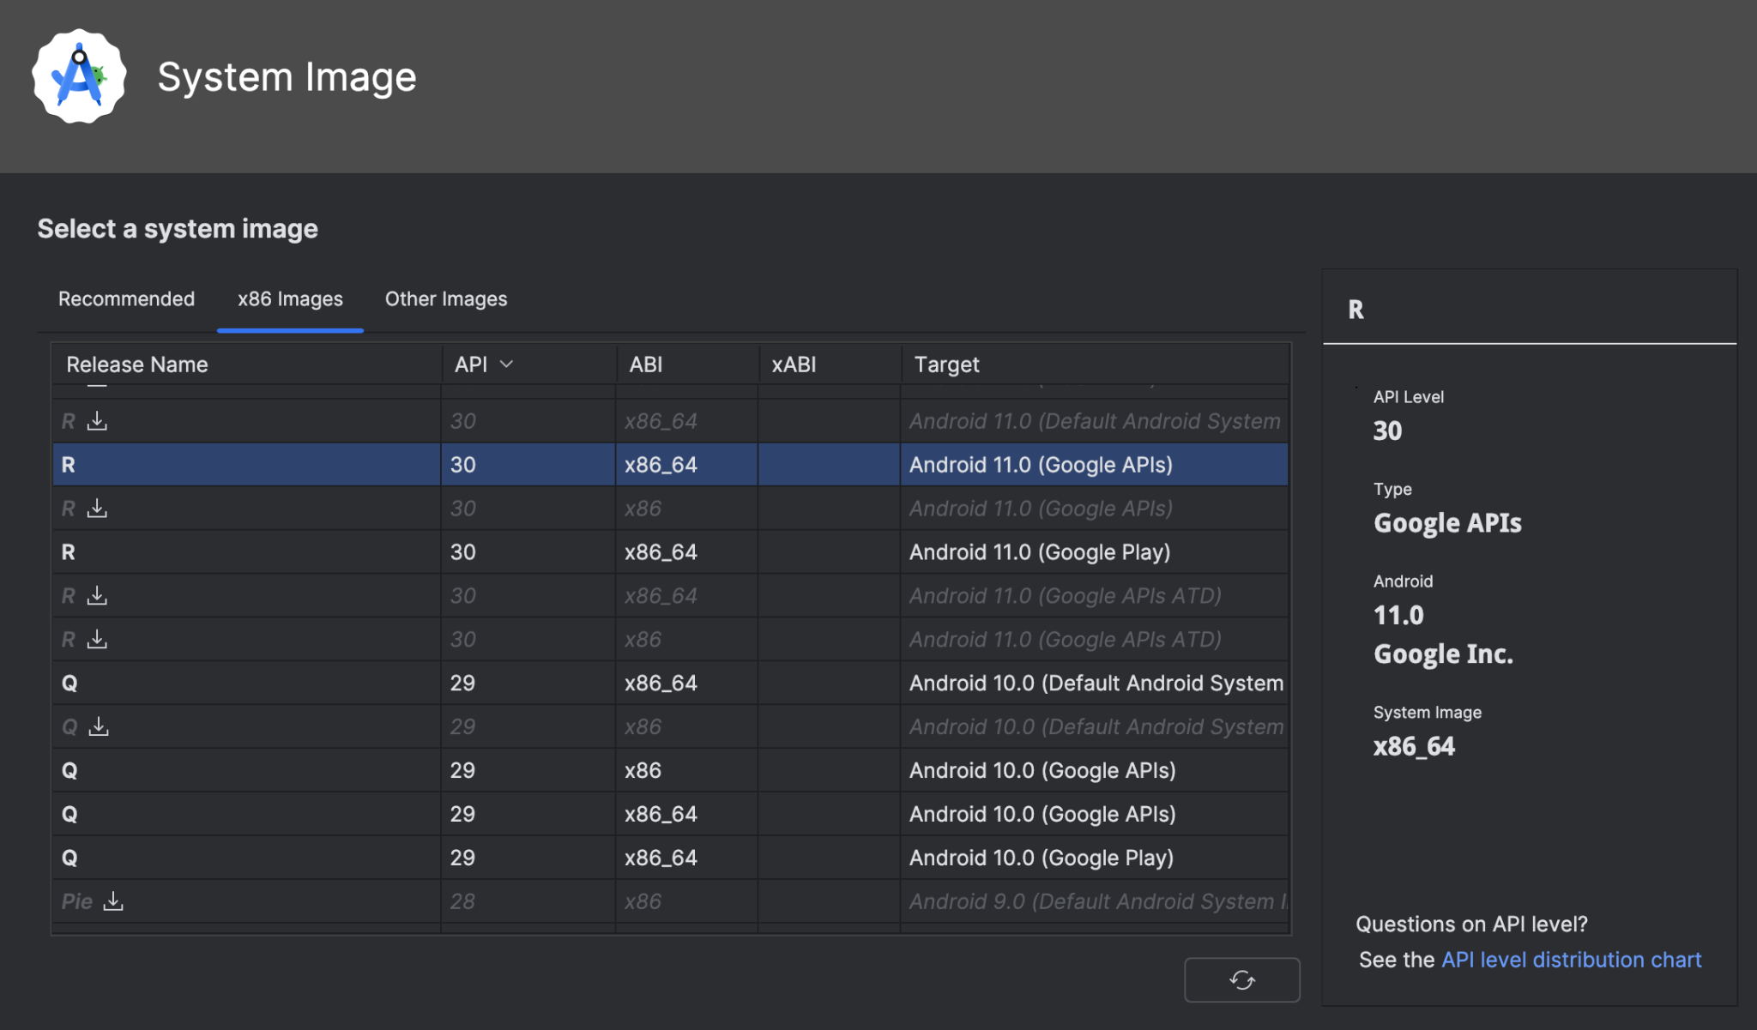
Step 2: Configuring the Emulator
From Device Manager tab, configure the the virtual device and launch it:
Pixel 7
SDK 30 x86_64 (R)
Google API version

Slide 8
Step 3: Rooting the Emulator
Start the emulator and navigate to the rootAVD folder in your terminal.
List all available AVDs by running:
$ ./rootAVD.sh ListAllAVDs
Locate the relevant ramdisk.img file for your emulator from the displayed list. Replace {ramdisk-path} with its path and execute:
$ ./rootAVD.sh system-images/android-30/google_apis/x86_64/ramdisk.img
Reboot the emulator. The device should now be rooted, and the Magisk app will be installed automatically."

Slide 9
Step 4: Configuring Charles Proxy
Download and launch Charles Proxy.
Set the port to 8888
Charles>Proxy>Proxy Settings> Port 8888
On the emulator, configure proxy in Settings>Advanced using local IP
Charles, Help>Local IP Addresses

Slide 10
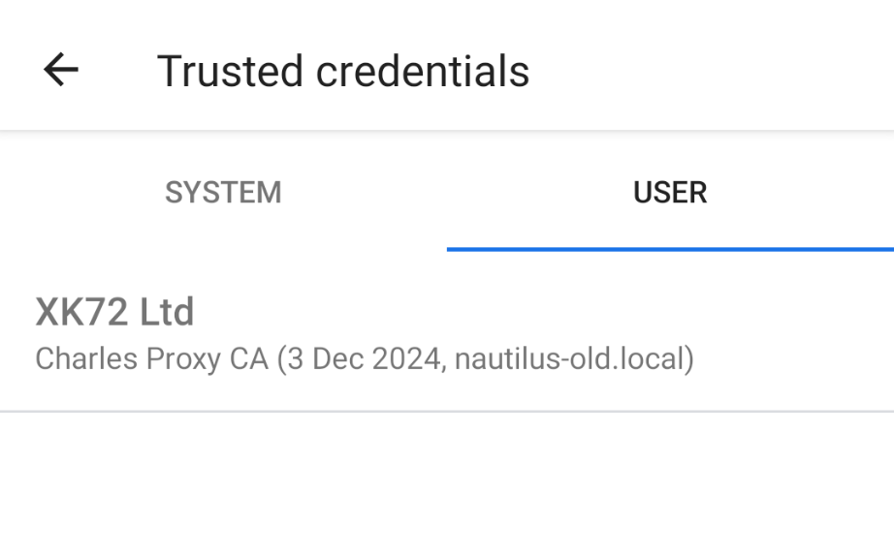
Step 5: Installing Charles Certificate
With Android 11, certificates must be installed via Settings.
On emulator, visit http://chls.pro/ssl and install the certificate (if you are unable to download the certificate, set proxy in wifi settings then turn on and off airplane mode).
Open Settings app and search for “CA certificate”
Install the downloaded .crt file
Search for “Trusted credentials” and check the installed Charles certificate.

Slide 11
Step 6: HTTPS Encrypted Traffic
Let’s now check the traffic a Language learning app generates on Charles.
Install the app .apk file on the Emulator.
On Charles, go to Proxy>Stop SSL Proxying.
Open the installed app and check Charles for the corresponding requests.

Slide 12
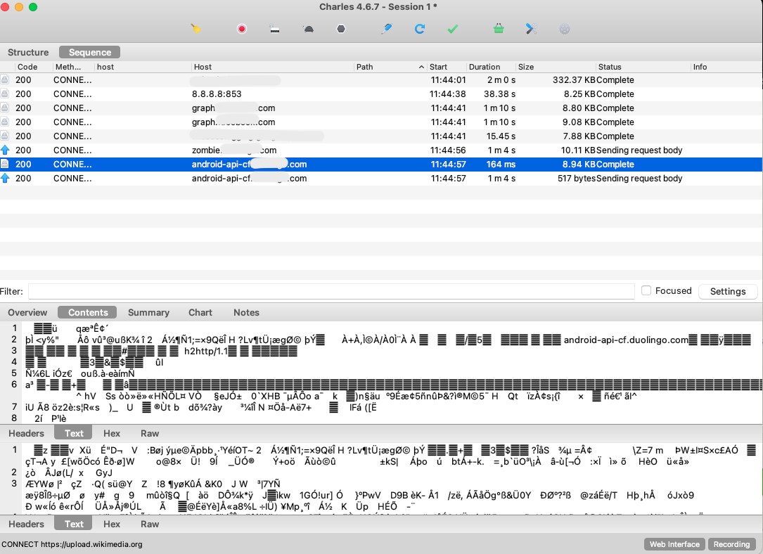
Step 6: HTTPS Encrypted Traffic
As expected, HTTPS content appears encrypted.

Slide 13
Step 7: Trusting User Certificate
We now need to convert the user-installed certificate to a System one.
In the emulator, open the Magisk app, let it perform initial actions and reboot the device if required.
Copy the AlwaysTrustUserCerts.zip file to the emulator’s internal storage:
$ adb push AlwaysTrustUserCerts.zip /sdcard/
In Magisk app, navigate to Modules>Install from storage.
Select the .zip file, then select Reboot after installation is complete.
Verify that the Charles certificate is also present in System Trusted Credentials.

Slide 14
Step 8: Decrypted HTTPS Traffic
Let’s check requests on Charles with the System Certificate installed.
Re-enable SSL proxying on Charles. Proxy>Start SSL Proxying.
Open the target App on the emulator and check requests on Charles

Slide 15
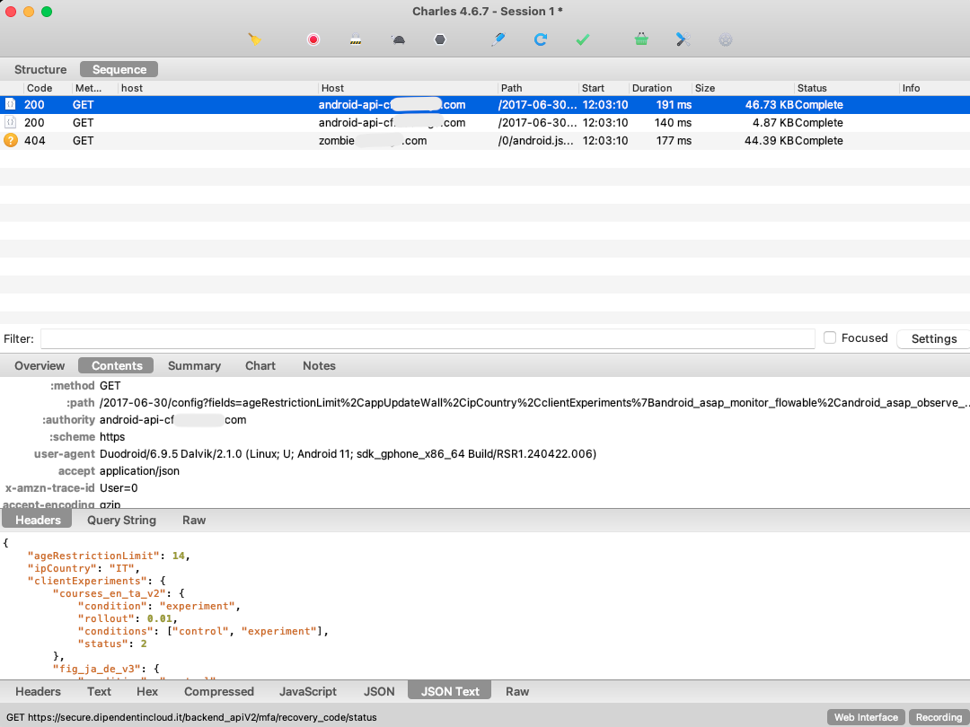
Step 8: Decrypted HTTPS Traffic
Congratulations! You are now able to access HTTPS requests content.

Slide 16
Extra: SSL Unpinning
The AlwaysTrustUserCerts Magisk module is compatible with Android up to SDK 30.
With more recent Android versions, I was not able to install certificates as System.
Furthermore, SSL pinning could be configured in the test app, only accepting certain certificate fingerprints. To bypass these limitation, SSL unpinning can be performed. This process modifies the APK file to remove certificate pinning, allowing you to trust custom user certificates.

Slide 17
Extra: android_unpinner
We can achieve SSL Unpinning leveraging android_unpinner.
Installation:
$ git clone https://github.com/mitmproxy/android-unpinner.git
$ cd android-unpinner
$ pip install -e
With emulator running, run the following :
$ android-unpinner all {path-to-my-apk.apk}
The unpinned application should be automatically installed on the emulator.

